Slide 1
西工大与A-Tune交流会

Slide 2
Centos/redhat上A-Tune移植工作
典型高性能计算应用（hpc）调优

Slide 3
A-Tune实现框架
A-Tune客户端
(atune-adm)
数据库(postgresql)
A-Tune 服务端（atuned）
远程http服务
gRPC 服务
AI 引擎
优化库管理
在线静态调优(analysis)
离线动态调优(tuning)
应用感知
数据监控
重要参数选择
sqlite3
模型训练
自动参数优化
本地http服务
MPI/CPI
数据采集
系统配置
Web UI

Slide 4
主要适配对象（https://gitee.com/openeuler/A-Tune-Collector）
module | purpose | 功能 | 工具命令
mem | bandwidth | collect cpu memory bandwidth | perf stat
 | numa | collect numa info | numactl
 | topo | collect memory topo | lshw
 | util | collect memory usage | sar
 | vmstat | collect virtual memory statistics | vmstat
net | info | collect nic config | ethtool
 | estat | collect network error statistics | sar
 | stat | collect network statistics | sar
 | topo | collect nic topo | lshw
perf | stat | collect perf stat info | perf stat
 | top | collect perf top info | perf record
cpu | info | collect cpu info | lshw
 | stat | collect cpu usage | mpstat
 | topo | collect cpu topo | lstopo
storage | stat | collect io usage of device | iostat
 | topo | collect storage info | lshw
sys | bios | collect the system bios info | lshw
 | fdutil | collect file handles usage | /proc/sys/fs/file-nr
 | interrupts | collect system device interrupts | /proc/interrupts
 | ldavg | collect system average load | sar
 | tasks | collect task context switching statistics | sar
采集模块

Slide 5
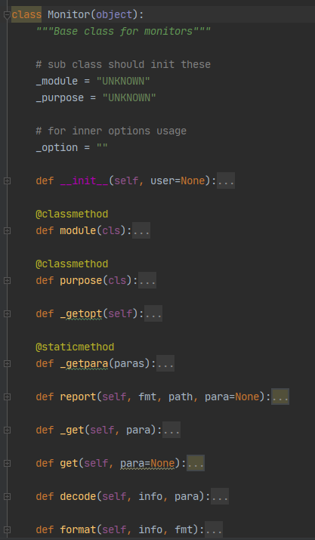
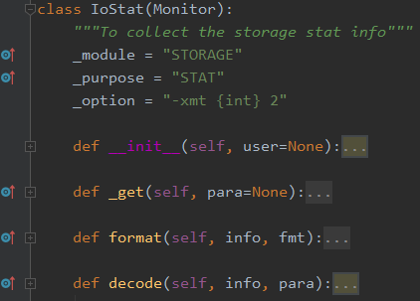
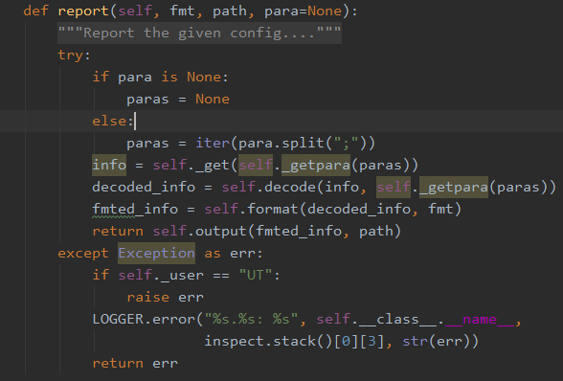
MPI：implement a new monitor

Slide 6
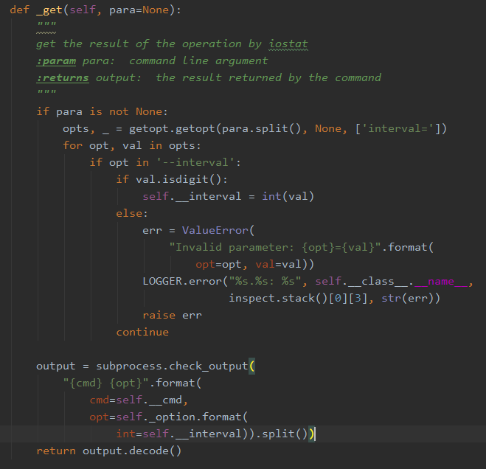
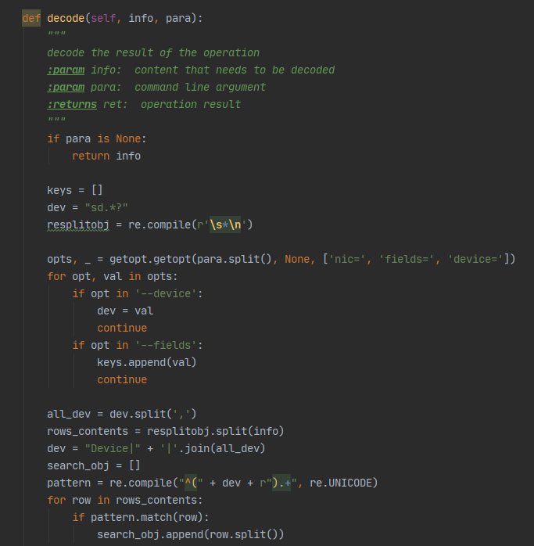
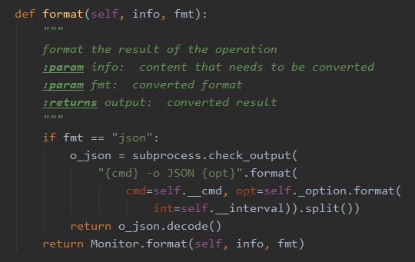
MPI：implement a new monitor

Slide 7
主要适配对象（https://gitee.com/openeuler/A-Tune-Collector）
module | submod | 功能 | 工具命令
affinity | irq | change the affinity of irqs | /sys/kernel/irq/ /proc/irq/{id}/smp_affinity
affinity | task | change the affinity of tasks | taskset
bios | bios | change the bios config | notify the user
bootloader | grub2 | change the grub2 config | /etc/grub2.cfg /etc/grub2-efi.cfg
file_config | file_config | change the profile | /etc/profile ……
kernel_config | kernel_config | change the kernel config | /boot/config-`uname -r`
script | script | the script extention of CPI
sysctl | sysctl | change the /proc/sys/* config | sysctl
sysfs | sysfs | change the /sys/* config
systemctl | systemctl | change the status of system services | systemctl
ulimit | ulimit | change the resources limit of user | /etc/security/limits.conf /etc/systemd/system.conf
配置模块

Slide 8
主要适配对象（https://gitee.com/openeuler/A-Tune-Collector）
module | submodule | 功能
script | blockdev | change the attribute value of device
 | ethtool | change the configuration of the ethernet
 | hinic | change the configuration of hinic driver module
 | hugepage | enable or disable huge page memory
 | ifconfig | change the configuration of the network
 | logind | change the configuration of login manager
 | openssl_hpre | enable or disable hpre hardware acceleration
 | prefetch | enable or disable cpu prefetch
 | sched_domain | change the configuration of cpu sched_domain
 | swap | swapoff or swapon
配置模块

Slide 9
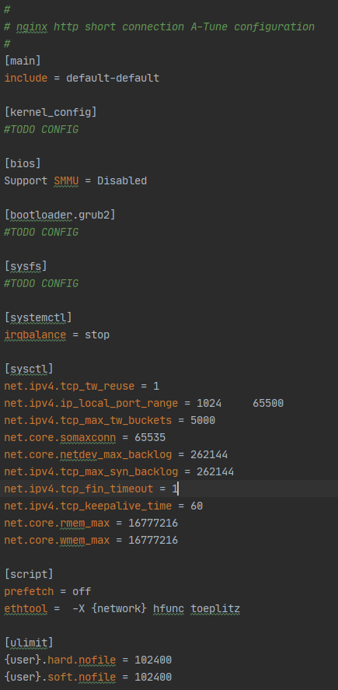
CPI：get or set the value of the given key

Slide 10
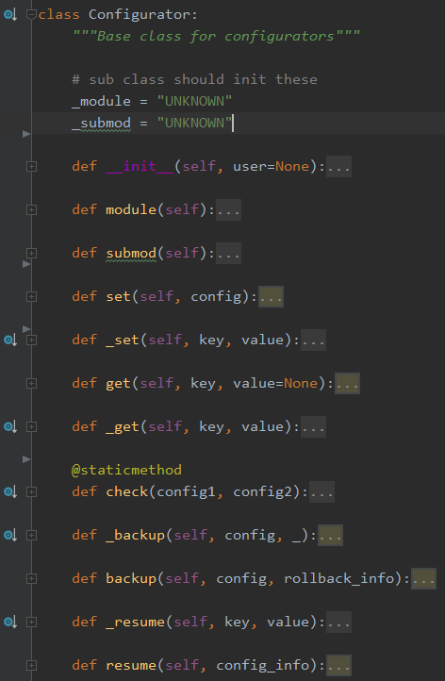
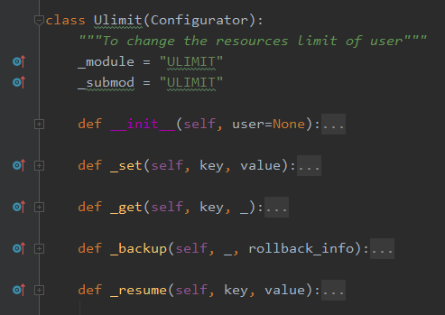
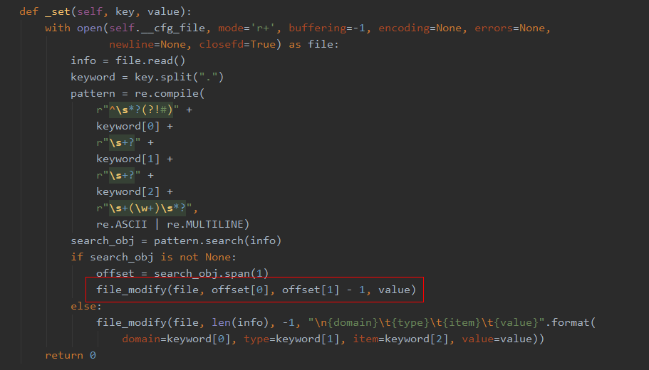
CPI：implement a new configurator

Slide 11
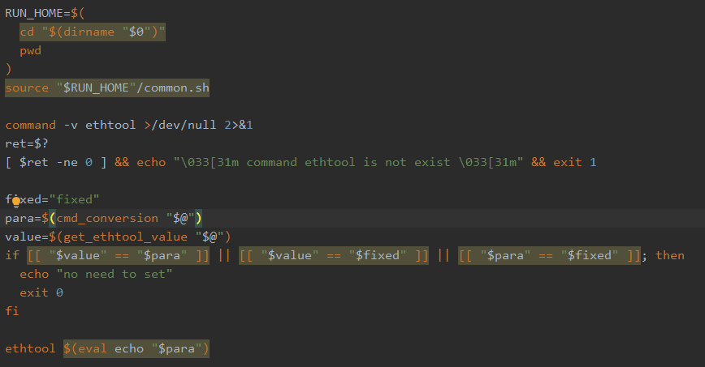
CPI： script extention

Slide 12
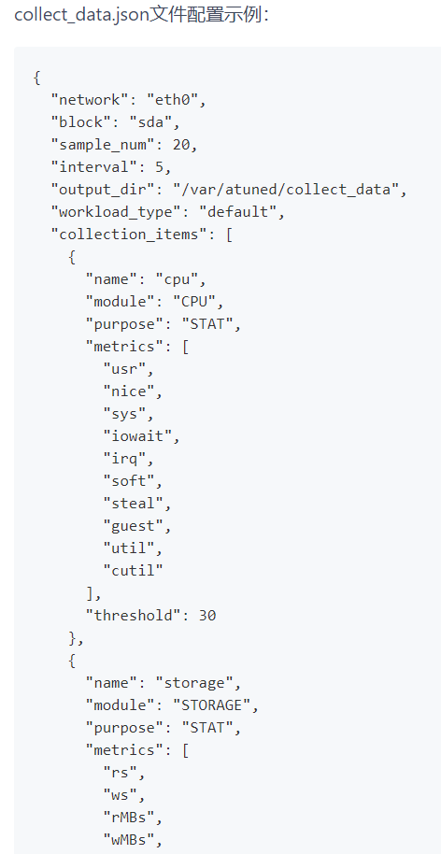
采集模块可适配
增删采集维度
修改json文件
多网卡数据采集
多磁盘数据采集

Slide 13
后期演进路线
业务场景、具体应用持续扩展，可调节对象、经验库持续增加，感知精度持续提升
采集模块能够适配更多的OS场景，支持更多的采集工具（nmon）
用户体验提升，可用性提升
……

Slide 14
相关issue

